Slide 1
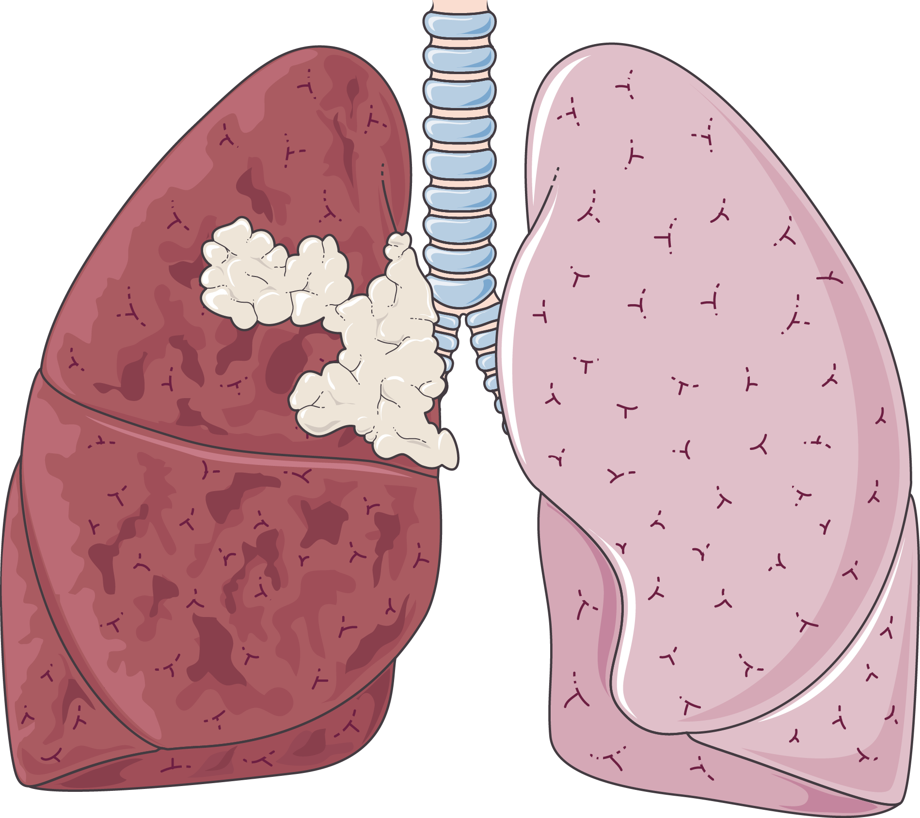
CBIO313: Investigating the role of miRNA editing in Lung Adenocarcinoma Classification using machine learning models
Under supervision of: Dr Muhammad Elsayeh
By: Sajda Hussien Tahoun
https://github.com/sajdahussien/LungCancerPrediction/blob/main/ProjectML.ipynb

Slide 2
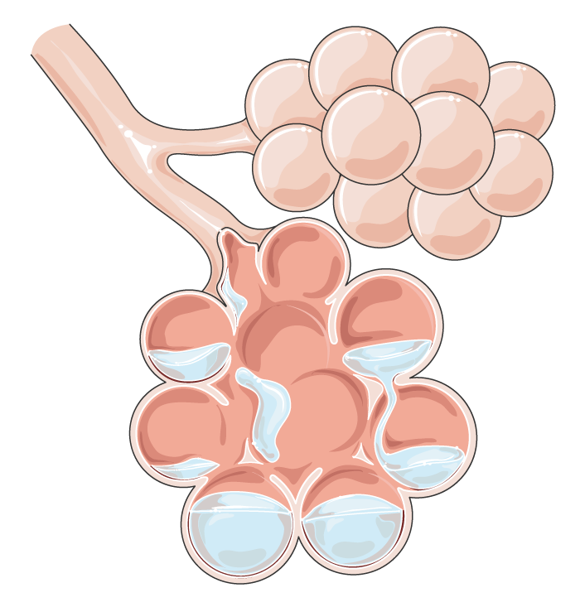
Table of contents
01
Introduction
02
Methodology
03
Results
04
Conclusion

Slide 3
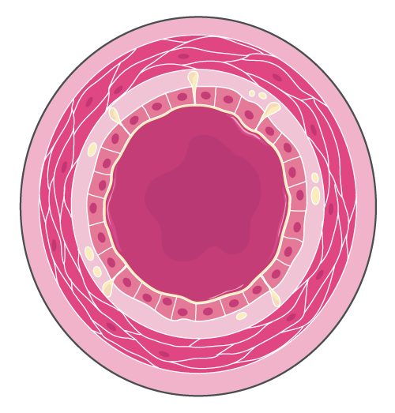
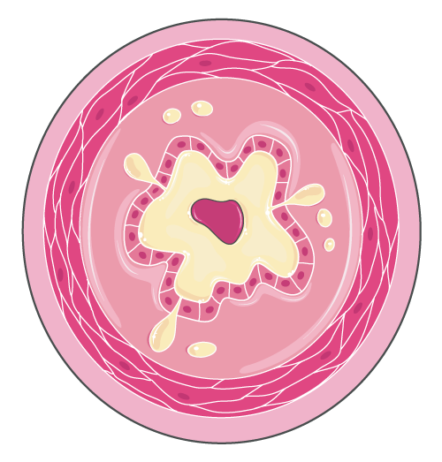
Introduction
Lung cancer is the primary cause of cancer deaths worldwide.
Adenocarcinoma is the most common type within lung cancers, classified as non-small-cell lung cancer (NSCLC).
MicroRNA editing, notably A-to-I conversion, affects tumour characteristics across various cancer types.
The Cancer Genome Atlas (TCGA) data reveals many microRNAs undergoing A-to-I editing in cancer samples.
Some of these edited microRNAs have prognostic implications for cancer patients.

Slide 4
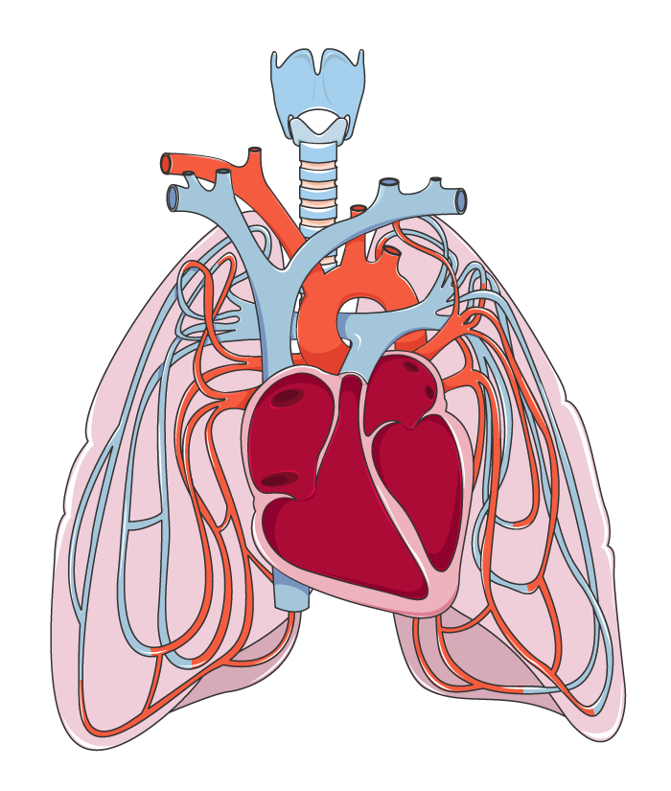
Dataset overview
The dataset comprises miRNA expressions across 38 samples.
It includes 19 samples from individuals diagnosed with lung adenocarcinoma and 19 samples from healthy controls.
Each sample consists of 2568 different miRNA expressions.
This dataset serves as the foundation for exploring the role of miRNA editing in lung adenocarcinoma classification using machine learning models.

Slide 5
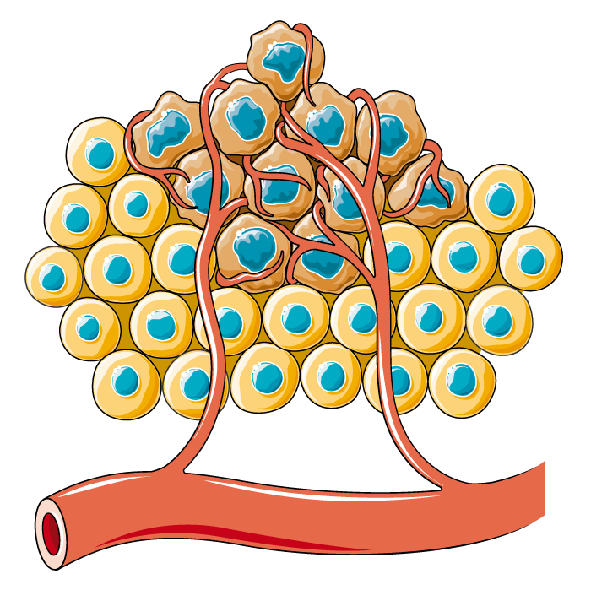

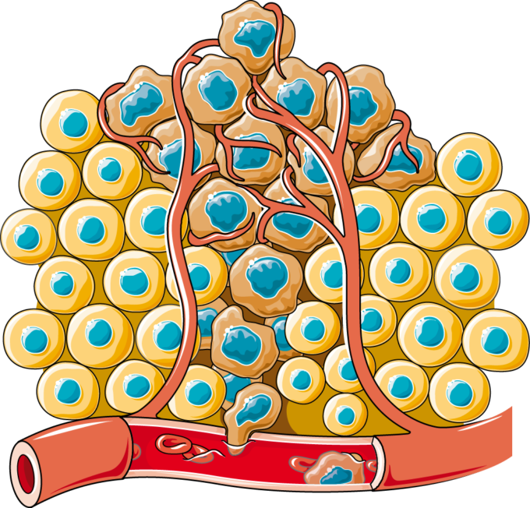
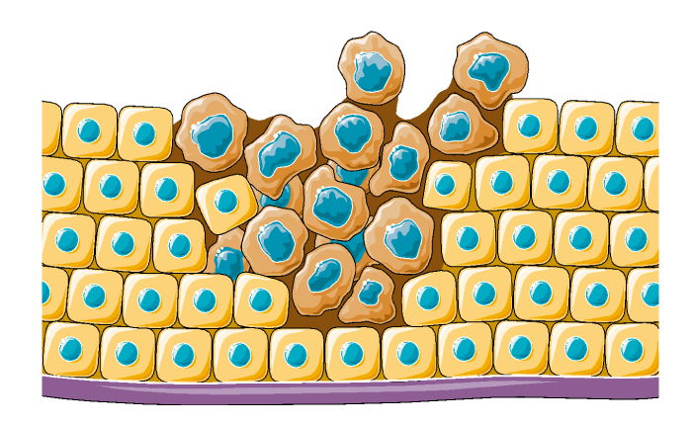
Methodology
01
02
03
04
05
Feature engineering
Model development
Model deployment
EDA and pre-processing
Model fine-tuning

Slide 6
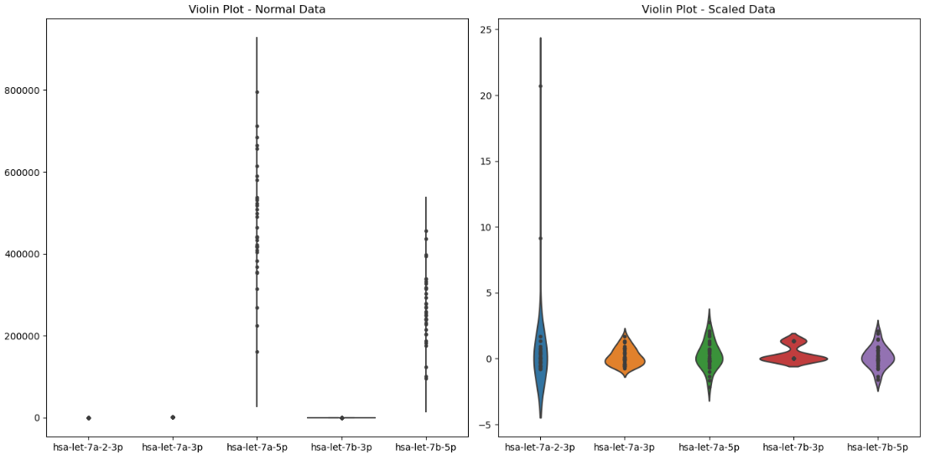
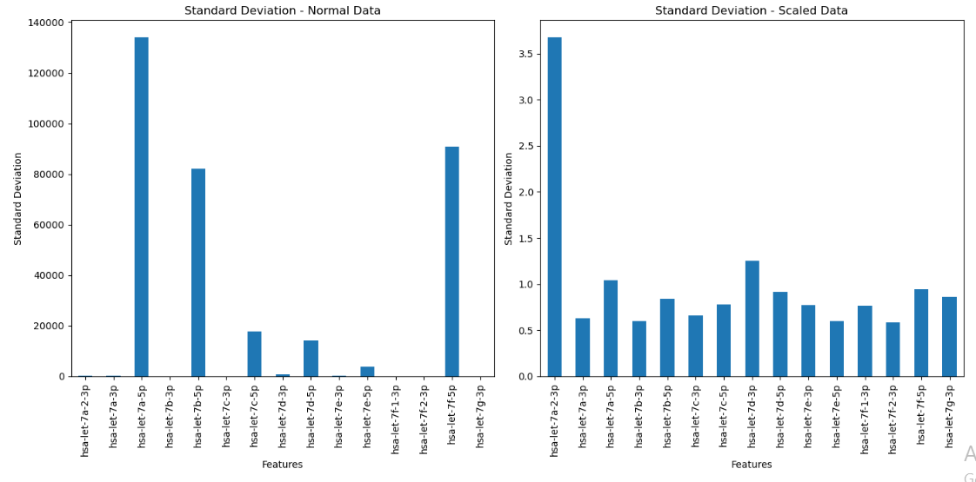
Results

Slide 7
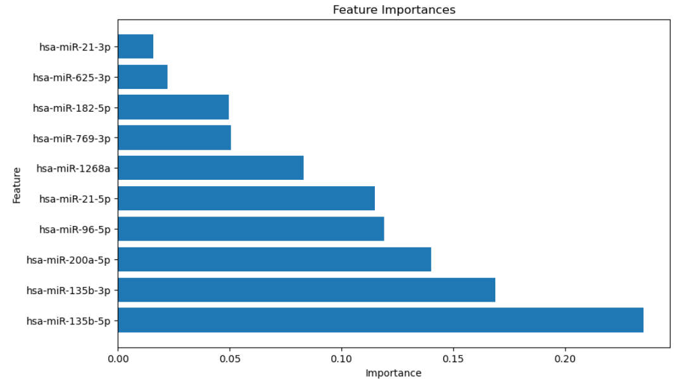
Results (cont.)

Slide 8
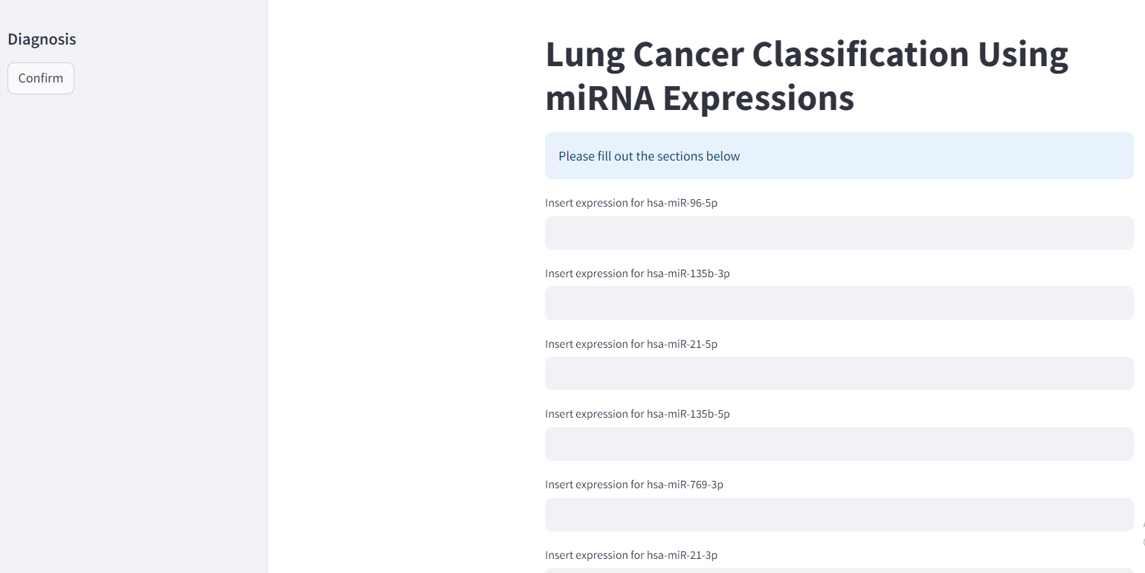
Results (cont.)

Slide 9
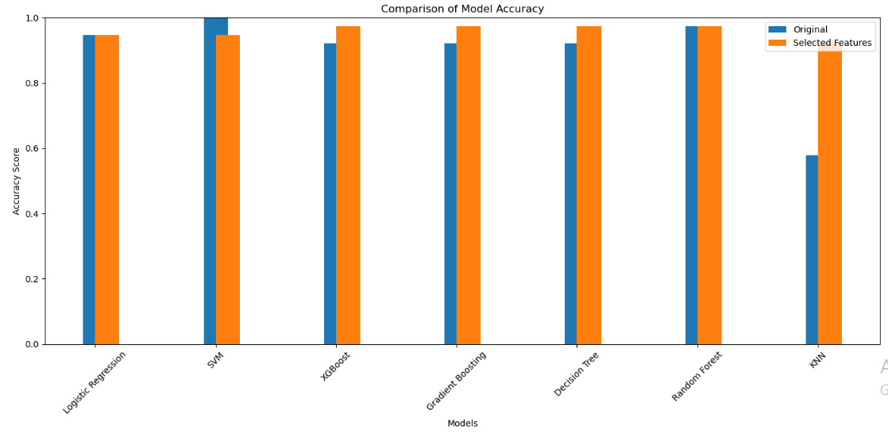
Results (cont.)

Slide 10

Conclusion
RF achieved a high accuracy of 97% when deployed on selected features.
Hyperparameter tuning did not lead to further improvements in RF model accuracy.
RF demonstrated robust performance in accurately classifying cancer based on miRNA editing expressions.

Slide 11
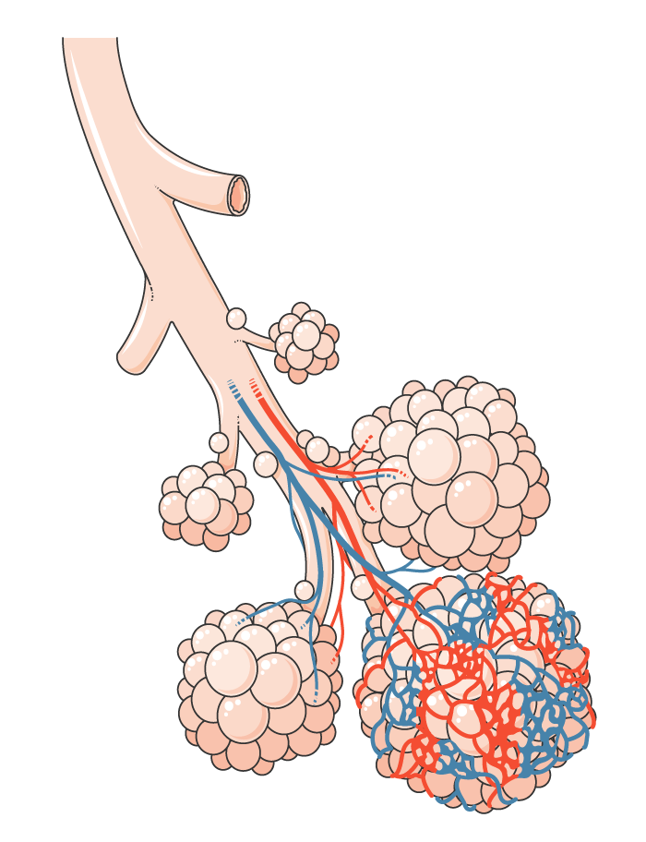
Limitations
The small sample size of 19 diseased and 19 control individuals may limit the generalizability of the findings.
Overfitting risk exists due to the limited sample size.
Future research should explore larger and more diverse datasets to validate the developed models' robustness.
Outlier handling using advanced techniques

Slide 12
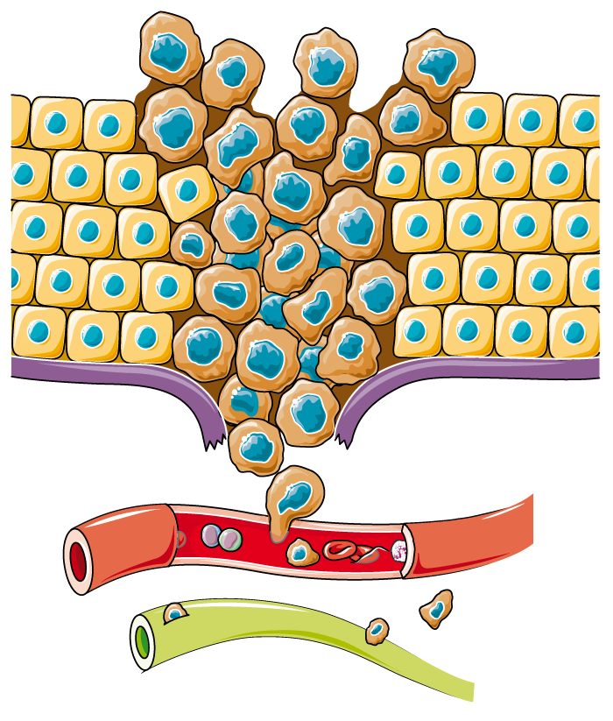
Thanks!
Do you have any questions?
https://github.com/sajdahussien/LungCancerPrediction/blob/main/ProjectML.ipynb

